Slide 1
Capstone Project : 1 Hotel Booking Analysis
Team Members:
Abinash Kanungo
Akash Kumar
Kunal Kamble
Zueb Ansari

Slide 2
Agenda
1. Problem Statement
2. Data Summary
3. Data Analysis
4. Challenges
5. Conclusions
6. Thank you

Slide 3
Problem Statements
1. What types of hotel in market and how many numbers of hotels in each type?
2. How Many Booking Were Cancelled for different types of hotels ?
3. Which is the most busy month for hotels ?
4. Which was the most booked accommodation type (Single, Couple, Family)?
5. Which type of meal booked ?
6. From which country most guests come?
7. Which type of market segment is used for booking hotels ?
8. How much guests pay per night for each type of room ?

Slide 4
Data Summary
1 ) ‘Hotel’: The category of hotels, which are two resort hotel and city hotel.
2 ) ‘Is Cancelled’: The value of column shows the cancellation type. If the booking was cancelled or not. Values [0,1], where 0 indicates not cancelled.
3 ) ‘Arrival Date year’: Year the customer arrived at the hotel.
4 ) ‘Arrival date Month’: Month the customer arrived at the hotel.
5 ) ‘Meal: Type of meal booked’; Undefined/SC – no meal package; BB – Bed & Breakfast; HB – Half board (breakfast and one other meal – usually dinner); FB – Full board (breakfast, lunch and dinner).

Slide 5
Data Summary(Cont…)
6) ‘Country’: The origin country of guest
7) ‘Market Segment’: This column show how reservation was made and what is the purpose of reservation. E.g., corporate means corporate trip, TA for travel agency.
8) ‘distribution channel’: The medium through booking was made.[Direct, Corporate, TA/TO, Undefined, GDS.]
9) ‘Assigned room Time’: Code of room type reserved. Code is presented instead of designation for anonymity reasons
10) ‘ADR’: Average rental revenue earned for an occupied room per day

Slide 6
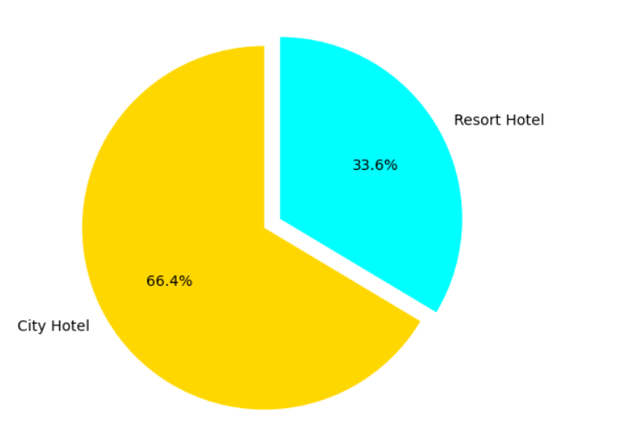
Data Analysis
1. What types of hotel in market and how many numbers of hotels in each type?
Out of 119390 Hotel bookings City hotel bookings which is 66.4% whereas Resort bookings makes 33.6%. Here by Count of City Hotel Bookings are more when compared to Resort Hotel.

Slide 7
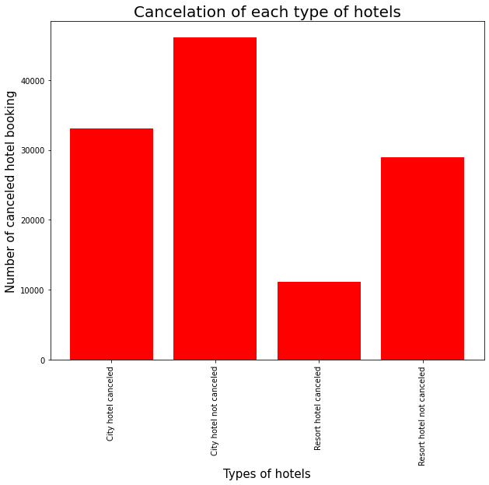
2. How Many Booking Were Cancelled for different types of hotels ?
We can say that city hotels bookings are more canceled than resort hotels.

Slide 8
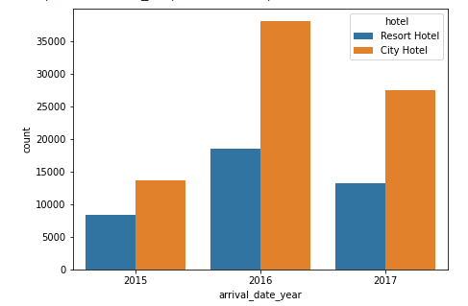
Year wise comparison of booking of hotels.
From above analysis we can say that in year 2016 most numbers of guests visited the both type of hotels.

Slide 9
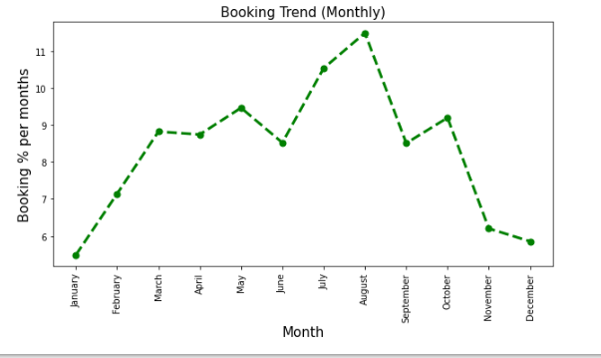
3. Which is the most busy month for hotels ?
With the Help of graph we can say that August is the busiest month for hotels, which means august month has most number of bookings.

Slide 10
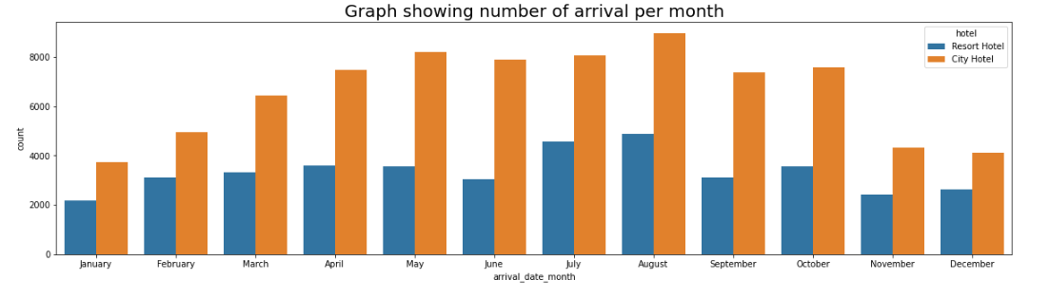
Now we will check comparatively for both types of hotels which month is busiest.
From above we can say that August is the busiest month for both type of hotels.

Slide 11
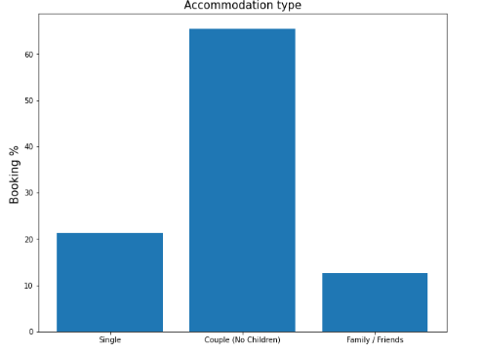
4. Which was the most booked accommodation type (Single, Couple, Family)?
From above plot bar we can say that Couples(No Children) has most number of booking.

Slide 12
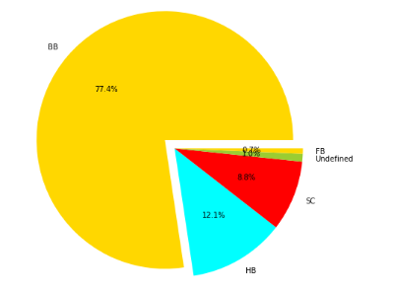
5. Which type of meal booked ?
As we can see from above graph BB i.e. Bed & Breakfast is most preferable meal type of the guests which is 77.4%

Slide 13
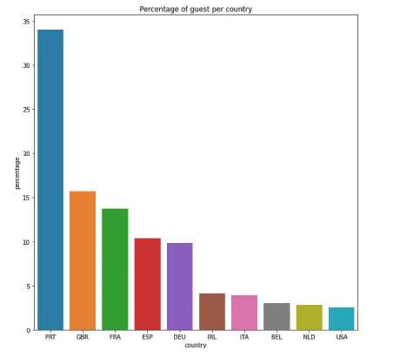
6. From which country most guests comes?
From above graph we can say that most of the guests come from PRT i.e. Portugal.

Slide 14
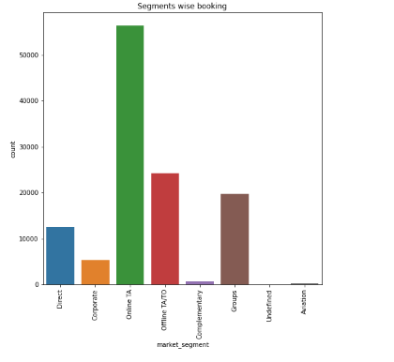
7. Which type of market segment is used for bookings hotels ?
From above graph we can say that online TA market segment is mostly used to book a hotel.

Slide 15
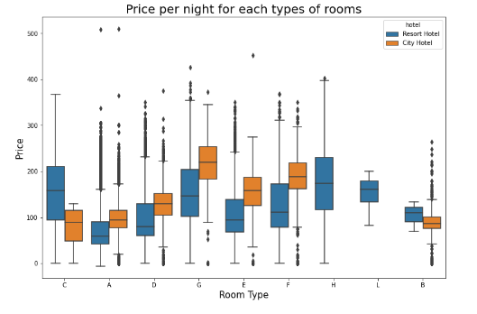
8. How much guests pay per night for each types of rooms ?
From above graph we can say that 'G' category room of city hotel are much costlier than other.

Slide 16
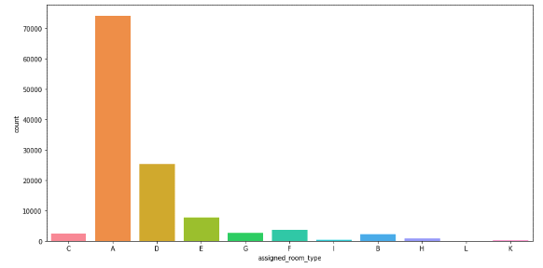
Assigned room type :
From above we can say that 'A' type rooms are most assigned room type among all.

Slide 17
Challenges:
1. Time taken to Identifying Problem Statements
2. Data Cleaning
3. Consideration of data subsets
4. Finding Suitable plots

Slide 18
Conclusion:
1. According to this analysis number of City hotels comparatively more than Resort hotels. Resort Hotel tend to be on the expensive side and most people will just stick with city hotel.
2. City hotels bookings are more canceled than resort hotels.
3. In year 2016 most numbers of guests visited the both type of hotels compare to other years.
4. August is the busiest month for hotels, which means august month has most number of bookings.
5. August is the busiest month for both type of hotels.

Slide 19
6. Couples (No Children) has most number of booking. 7. BB i.e. Bed & Breakfast is most preferable meal type of the guests which is 77.4%
8. Most of the guests come from PRT i.e. Portugal.
9. Guest uses most online TA market segment for hotels booking.
10. G' category room of city hotel are much costlier than other.
11. A' type rooms are most assigned room type among all.

Slide 20
Thank You

